Slide 1



The Dawn of Language
By Flore Claes

Slide 2

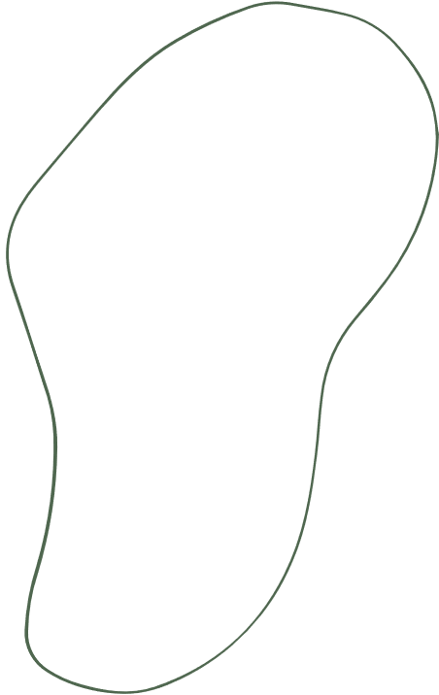


Chapter 2: The Dawn of Language

Slide 3

Topics Covered
  Difference between Neanderthals and Homo sapiens sapiens
Agenda
  The five theories for how speech originated
  Why do we speak the language we do?
  Which languages are descended from which?

Slide 4
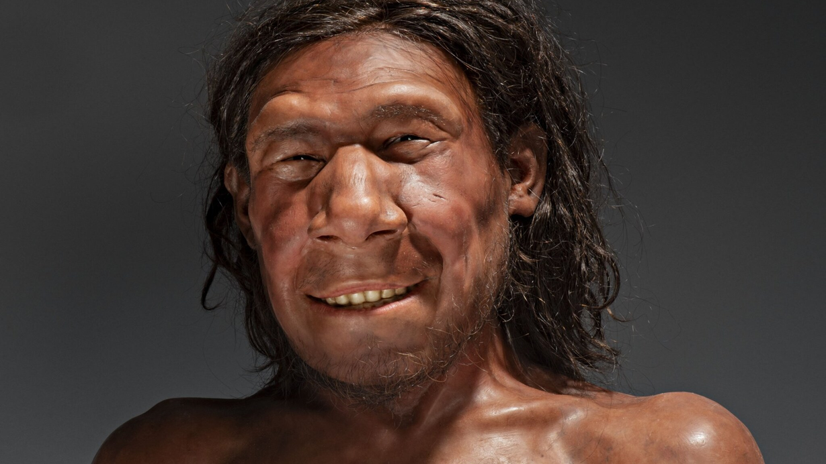
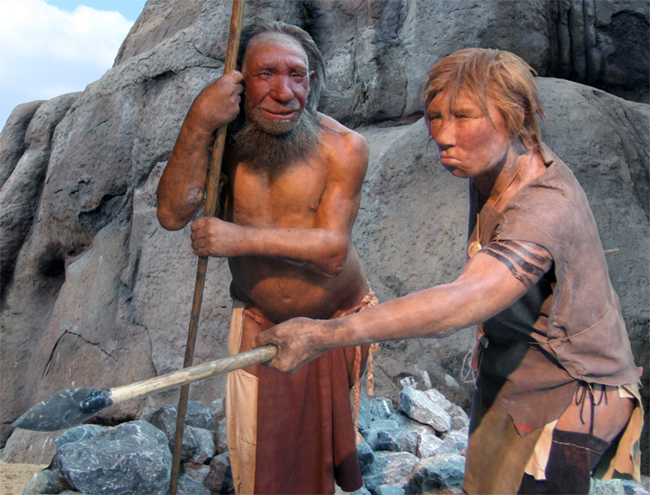
The Neanderthal
  Europe, Near East, north of Africa
  Appearance
  Language
  Nasal-sounding & imprecise
  Interbreeding?
  Dissapeared

Slide 5
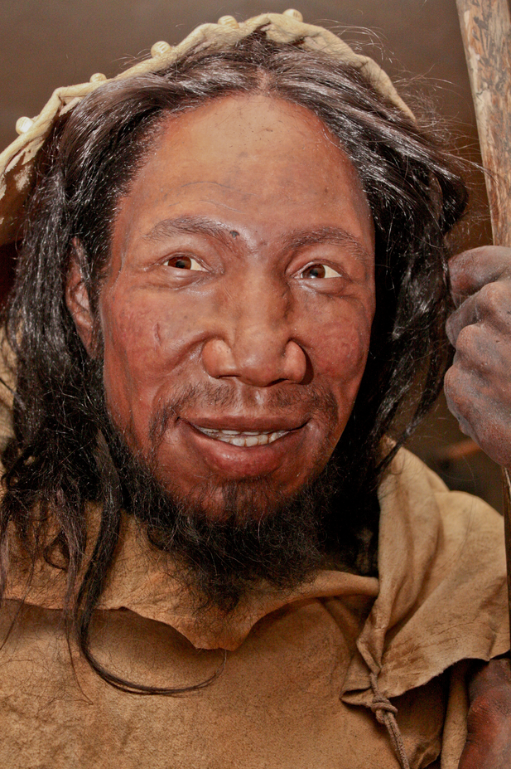
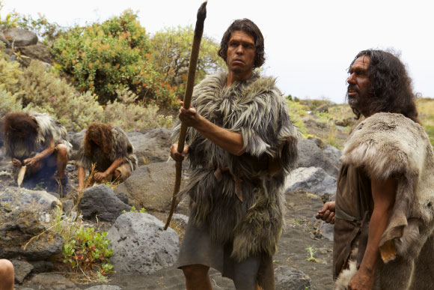
Homo sapiens sapiens
  Appearance
  Originated in Africa
  Identical
  Distinguished them
  Choke on food
  Well-articulated speech
  Larynx

Slide 6
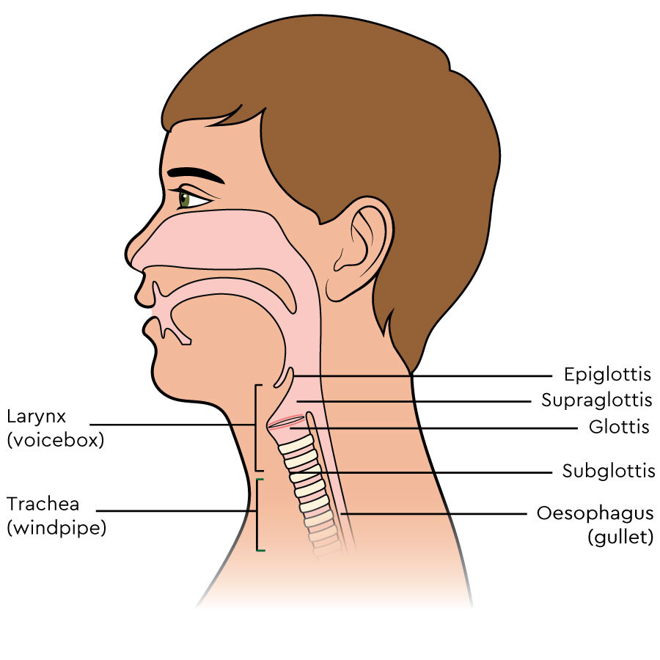

Slide 7
An example
"Let's kill some red deer today. You take a big stick and drive them out of the forest and we will be ready with our spears to kill them when they run towards us"
"I'm hungry, let's go hunting."
The Neanderthal
Homo sapiens sapiens

Slide 8
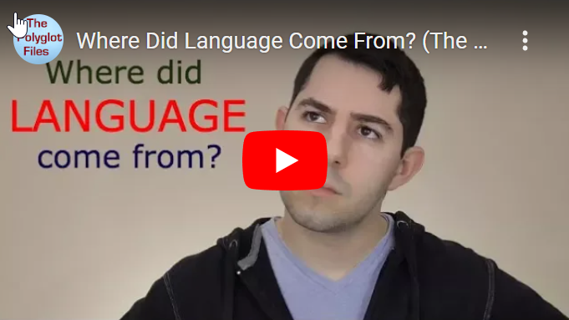
  Bow-Wow theory
-> animals
  Pooh-Pooh theory
-> reaction
  Ding-Dong theory
-> vibrates
  Yo-He-Ho theory
-> vital actions
  Ta-Ta theory
-> tongue
The 5 theories
https://shorturl.at/aFI25

Slide 9
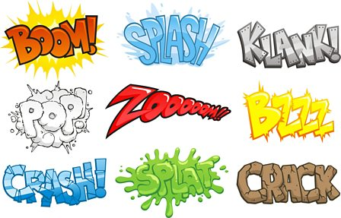
onomatopoeia
  Sound imitation
  Consecutive letters

Slide 10
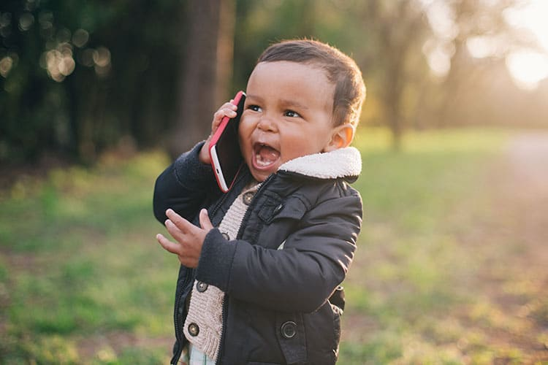
why do we speak the language we do?
  Blank sheet
  Noam Chomsky
  Children
  Dependent on their educators

Slide 11
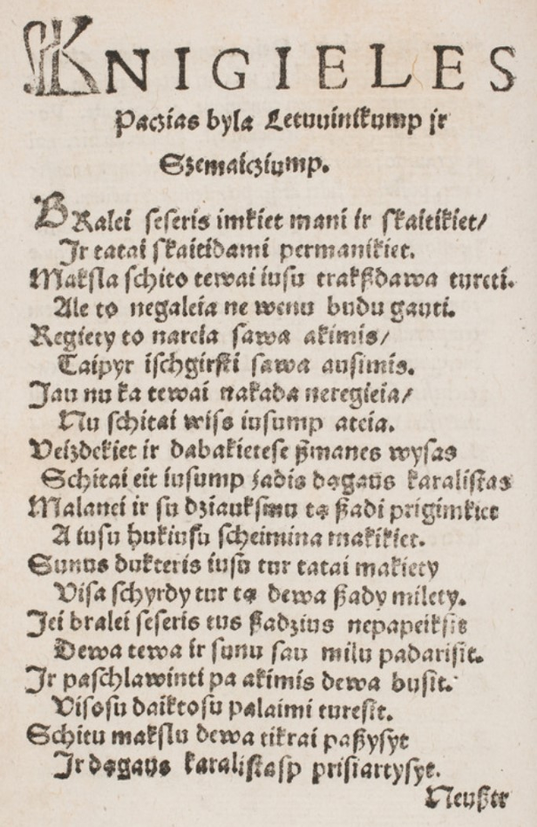
which languages are descended from which?
  Closely related
  Indo-European
  Lithuanian

Slide 12
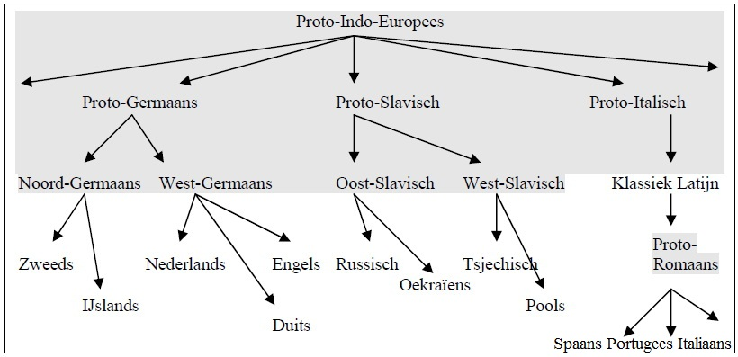

Slide 13
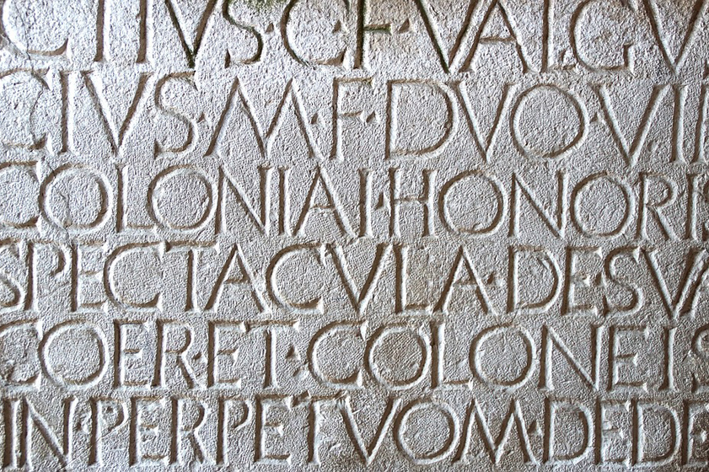
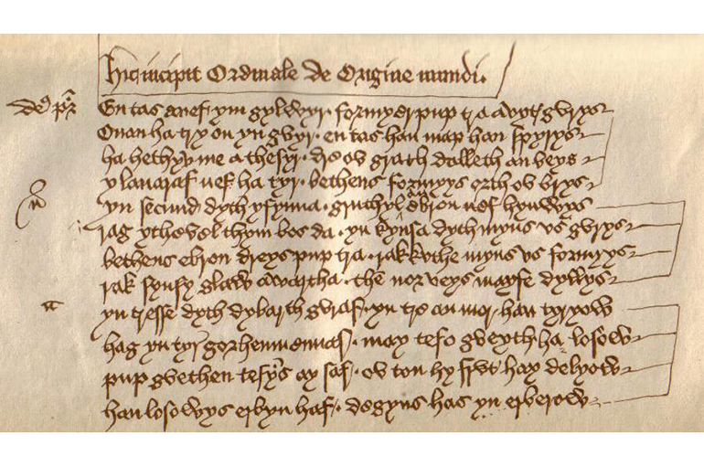
Latin & Celtic
  Evolved
  Science and literature
  Lugudorese
  Central Sardinia
  Variations
  Different everywhere

Slide 14

Conclusion
  guess
  no sources
  later sources & science

Slide 15
sources
  Michael Cristiano, M. (17/07/2017). Where did language come from?: https://shorturl.at/aFI25
  Bryson, B. (1990). Mother Tongue: The English Language

