Slide 1




is animal communication language?
by Flore Claes

Slide 2


Language
communication
There is a thin line
Language
Evolves
Structured system of communication
Consists of grammar and vocabulary
Communication
Static
Process of sending and receiving messages

Slide 3
table of contents
COMPARISON OF THE COMMUNICATION SYSTEM OF HUMANS AND ANIMALS
IS TRANSLATION POSSIBLE?
1
4
PETER L. TYACK
DO ANIMALS UNDERSTAND OUR LANGUAGE?
2
5
SIMILARITIES
CONLUSION
3
6

Slide 4
COMPARISON OF THE COMMUNICATION SYSTEM OF HUMANS AND ANIMALS
Human | Animal

Slide 5


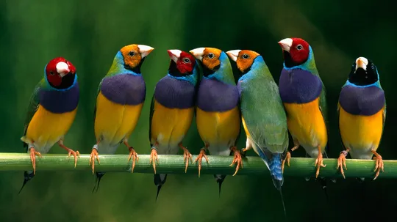
bird communication
Perching birds
Three main ways of communication
  Bird song
  Call notes
  Behavior
Similar vocal organ to humans
  Humans: Larynx
  Birds: Syrinx

Slide 6
COMPARISON OF THE COMMUNICATION SYSTEM OF HUMANS AND ANIMALS
Human | Animal
A word or a sign can have a different meaning | Every sign or sound has only one meaning.

Slide 7


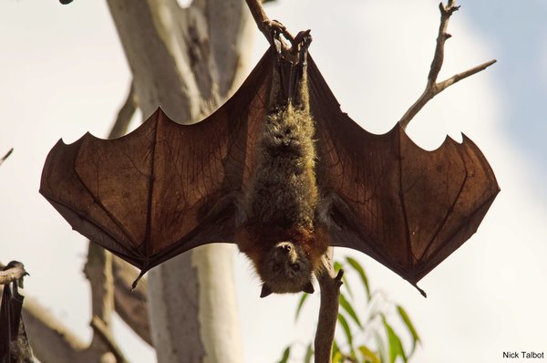
bat communication
High pitch screeches and grunts
  Large colonies
  They can distinguish vocalization
Their vocalization
  Only when clustered together
Frequency height
  Humans: 20 - 20.000 waves per second
  Bats: over 100.000 waves per second
Biological sonar
  Echolocation

Slide 8
COMPARISON OF THE COMMUNICATION SYSTEM OF HUMANS AND ANIMALS
Human | Animal
A word or a sign can have a different meaning | Every sign or sound has only one meaning.
The ability to talk about absent object and events | Communicate only about things that are present

Slide 9
COMPARISON OF THE COMMUNICATION SYSTEM OF HUMANS AND ANIMALS
Human | Animal
A word or a sign can have a different meaning | Every sign or sound has only one meaning.
The ability to talk about absent object and events | Communicate only about things that are present
Complex grammar | No complex grammar

Slide 10
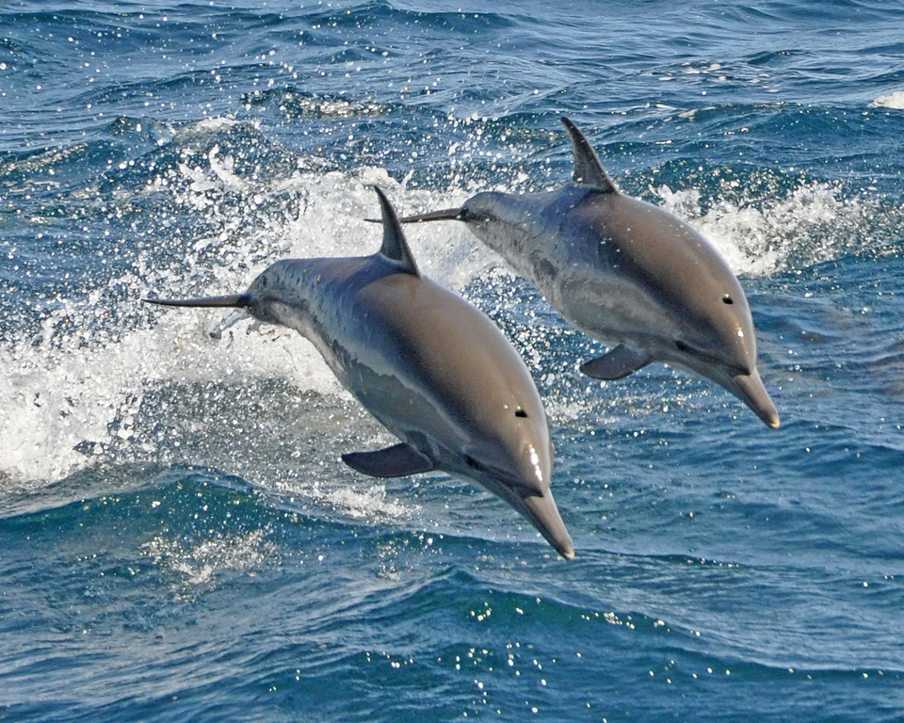
dolphin communication
Perhaps like humans?
Sonar system
  Similar with bats
Signature whistles
  Characteristic of each dolphin individually
  Cognitive function
The information after echolocation
  A pattern

Slide 11
COMPARISON OF THE COMMUNICATION SYSTEM OF HUMANS AND ANIMALS
Human | Animal
A word or a sign can have a different meaning | Every sign or sound has only one meaning.
The ability to talk about absent object and events | Communicate only about things that are present
Complex grammar | No complex grammar

Slide 12
COMPARISON OF THE COMMUNICATION SYSTEM OF HUMANS AND ANIMALS
Human | Animal
A word or a sign can have a different meaning | Every sign or sound has only one meaning.
The ability to talk about absent object and events | Communicate only about things that are present
Complex grammar | No complex grammar
Can easily invent new words | Have to evolve in order for their sings to change

Slide 13


Peter L. Tyack
Limited and complex vocal learning
  A big enough brain
  Neural mechanisms
Difference in complexity
  The small size of their brain
  Short-term memory limits
The previous examples
  Bird & bats -> small brain
  Dolphins -> similar-sized brains as humans

Slide 14
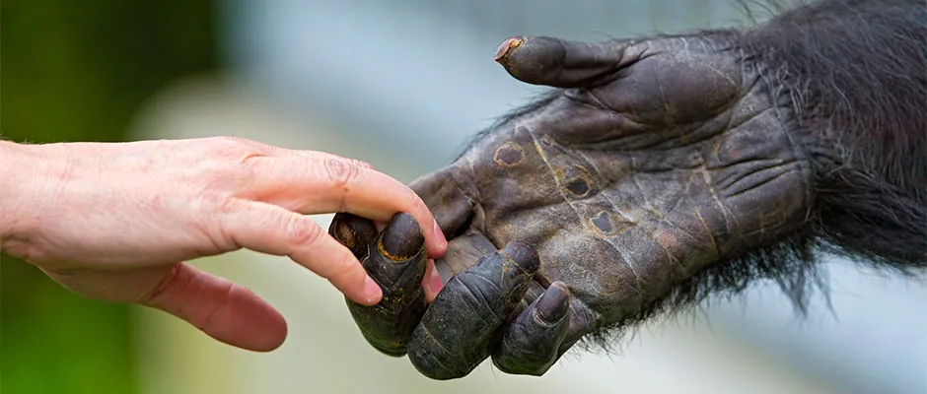
similarities between human language and animal communication
Spontaneous use of sound
  The inner need -> as result of emotions
  Humans: when we hurt ourselves
  Dogs: when their paw is stepped on
Body language
  Humans: a closed posture
  Cats: put their ears back
Turn-taking
  We tend to take turns talking or communicating

Slide 15

Could you translate animal “Language” into our language?
“True translation” -> nearly impossible
Wittgenstein
  “If a lion could speak, we could not understand him, because a lion’s form of life is so alien to ours that we cannot seriously claim to know what the lion means by what the lion says.”
  See the world from the perspective of the speaker
  All the living beings -> communicate in their own “language”
https://t.ly/MnvBq

Slide 16

Do animals understand our language?
Paying attention to
  Gestures
  Body language
  The tone of our voice
Training
Works in two directions

Slide 17
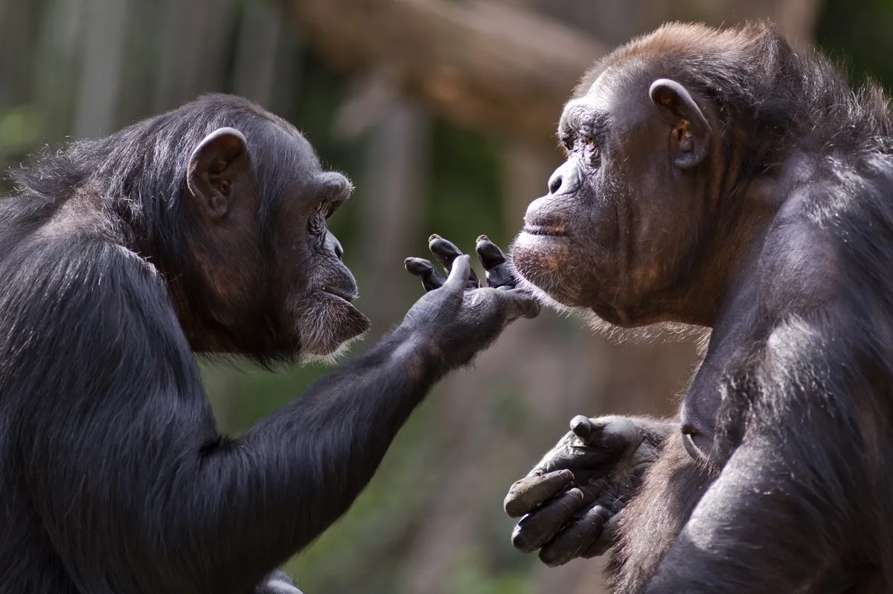
animal communication language
We share a few basic criteria based on communication
  Spontaneous sound use
  Body language
  Turn-taking
Supported by Peter L. Tyack's studies
  Brain size
  Neural mechanisms
Wittgenstein's ideas
  We are not capable to understand the “language” of other species
Animals do not truly understand us
  Gestures, body language and the tone of our voice

Slide 18
sources
  Fishbein, A. R., Fritz, J. B., Idsardi, W. J., & Wilkinson, G. S. (2019). What can animal communication teach us about human language? Philosophical Transactions of the Royal Society B, 375(1789), 20190042. https://doi.org/10.1098/rstb.2019.0042
  Study.com. (n.d.). Animal Communication: Types & Examples. Retrieved, from https://study.com/learn/lesson/animal-communication-types-examples.html
  Quora. (n.d.). What are the similarities between human and animal languages? Retrieved, from https://www.quora.com/What-are-the-similarities-between-human-and-animal-languages#:~:text=Human%20and%20animal%20languages%20share,and%20gestures%20to%20convey%20information.
  Do some animals understand your language? Which animals? (n.d.-c). https://www.vedantu.com/question-answer/do-some-animals-understand-your-language-which-class-12-biology-cbse-5f7c0c8e6e82ed3f5f5e8b93
  Vedantu. (n.d.). Do Some Animals Understand Your Language? [Class 12 Biology CBSE], from https://www.vedantu.com/question-answer/do-some-animals-understand-your-language-which-class-12-biology-cbse-5f7c0c8e6e82ed3f5f5e8b93
  Smith, J. (2015). The Language of Dolphins. Retrieved February 8, 2024, from https://www.researchgate.net/publication/280013235_De_taal_van_dolfijnen
  What method do bats communicate? (n.d.). http://www.aaanimalcontrol.com/professional-trapper/batcommunicate.html#:~:text=Bats%20usually%20communicate%20with%20each,over%20100%2C000%20waves%20per%20second
  Bird Communication: Understanding how birds communicate. (2023, November 15). Birdfact. https://birdfact.com/bird-behavior/communication

Slide 19
sources
  Sichel, B., & Sichel, B. (2024, February 1). Language vs. Communication: They’re Not the Same Thing - ILS Translations. ILS Translations - Technical Translation Services. https://www.ilstranslations.com/blog/language-vs-communication-theyre-not-the-same-thing/#:~:text=Language%20is%20a%20system%20of,a%20process%20of%20transferring%20messages.
  Tyack, P. L. (2019). A taxonomy for vocal learning. Philosophical Transactions of the Royal Society B, 375(1789), 20180406. https://doi.org/10.1098/rstb.2018.0406
  Warner, A. (2022, September 12). “Animal translation” generates media buzz — does it work? MultiLingual Media LLC. https://multilingual.com/animal-translation/#:~:text=That's%20because%20animals%20and%20humans,have%20on%20animal%20communication%20systems.
  Do some animals understand your language? Which animals? (n.d.-b). https://www.vedantu.com/question-answer/do-some-animals-understand-your-language-which-class-12-biology-cbse-5f7c0c8e6e82ed3f5f5e8b93
  Anonymous. (n.d.). [The Similarities and Differences between Animal and Human Communication] [PDF document]. Retrieved from https://academics.su.edu.krd/public/profiles/alaa.aula/supervision/supervision-2858-18065-1683912321-1.pdf
  Ellis, D. (2022, December 1). If an alien could speak, could we understand it? Leeds Trinity University. https://research.leedstrinity.ac.uk/en/publications/if-an-alien-could-speak-could-we-understand-it#:~:text=Wittgenstein%20famously%20remarked%20'if%20a,by%20what%20the%20lion%20says.
  ILSTranslations. (n.d.). Language vs. Communication: They're Not the Same Thing. Retrieved from https://www.ilstranslations.com/blog/language-vs-communication-theyre-not-the-same-thing/#:~:text=Language%20is%20a%20system%20of,a%20process%20of%20transferring%20messages
  Sciencing. (n.d.). How Do Birds Communicate? Retrieved from https://sciencing.com/birds-communicate-4567063.html

Slide 20
sources
  PubMed. (n.d.). Bat Study Reveals Secrets of the Social Brain. Retrieved from https://pubmed.ncbi.nlm.nih.gov/31735157/
  StudySmarter. (n.d.). Human Language and Animal Communication. Retrieved from https://www.studysmarter.co.uk/explanations/psychology/social-context-of-behaviour/human-language-and-animal-communication/#:~:text=Human%20and%20animal%20communication%20similarities,-The%20remaining%20seven&text=The%20use%20of%20the%20vocal,arbitrary%20sounds%20to%20convey%20meaning
  UC Berkeley News. (2021, October 21). Bat Study Reveals Secrets of the Social Brain. Retrieved from https://news.berkeley.edu/2021/10/21/bat-study-reveals-secrets-of-the-social-brain
  OwlCation. (n.d.). The Difference Between Animal and Human Communication. Retrieved fromhttps://owlcation.com/stem/The-difference-between-animal-and-human-communication
  Key Differences. (n.d.). Difference Between Language and Communication. Retrieved from https://keydifferences.com/difference-between-language-and-communication.html

Slide 21

thank you for listening!
Are there any questions?

